Slide 1
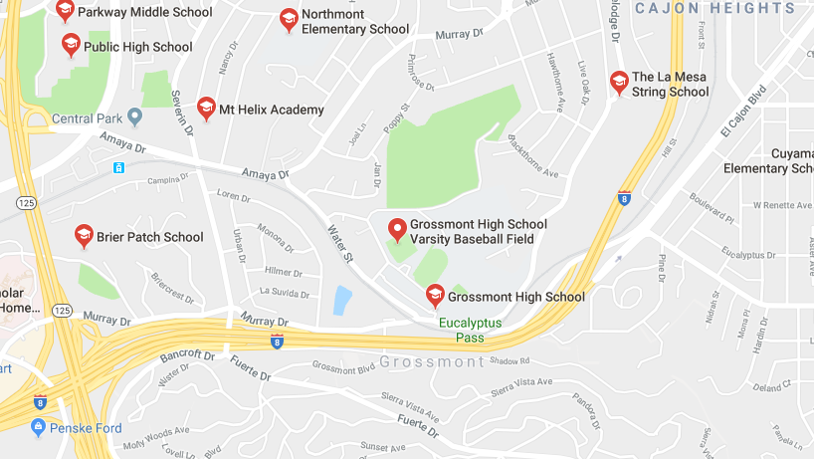
1.6 miles walking distance
1.2 miles walking distance
1.3 miles walking distance
.8 miles walking distance
Amaya Drive Station
.9 miles walking distance
.8 miles walking distance
.6 miles walking distance
.4 miles walking distance - shares bus stops/municipal lines/public transportation with 2,296 students
Proposed leasing site for CDCR, Adult Parole Operations at 9400 Grossmont Summit Drive, La Mesa, CA 91941
Incompatible with adjoining residential community, limited commercial presence, heavy residential only
Violates principal use for Residential Business (RB) zone involving operations and vehicles.
Endangers thousands of students, parents, and neighborhoods within walking distance, intersecting commutes
Does not meet Chapter 24 parking and traffic congestion requirements – no street parking, not enough space for
1 space per 300 s.f. GLA, and single lane, two-way street with no outlet (dead-end)

Slide 2
Proposed Department of Corrections and Rehabilitation (CDCR), Division of Adult Parole Operations (DAPO) location at: 9400 Grossmont Summit Drive, La Mesa CA 91941 Let’s all keep La Mesa safer, and Mt Helix thriving. Please pass this along, and sign the petition here: https://www.change.org/p/mr-steve-lamirand-stop-adult-parole-operations-from-opening-in-mt-helix-la-mesa
Proposed location is incompatible with adjoining residential community, limited commercial presence, and intensity of use for Residential Business (RB) Zone.
Proposed location violates permitted principal use for Residential Business (RB) zone that does not include ongoing services, nor operations including the parking or dispatching of vehicles.
Proposed location does not meet minimum parking requirements and impedes traffic congestion on residential single-lane streets with no outlet on Grossmont Summit Drive.
Violates La Mesa intent to “provide properly designed parking areas of adequate capacity and circulation patterns to reduce traffic congestion, facilitate movement, enhance public safety..” Off-site street parking unavailable. Grossmont Summit Dr lacks any non-building or structure parking west of Grossmont Blvd, requiring more street parking closer to Grossmont High School.
Violates minimum parking of 1 per each 300 s.f. GLA per proposed leasing unit and available s.f. GLA.
Impedes traffic flow on single lane, two-way dashed yellow line with no outlet (dead-end).
Proposed location endangers thousands of children, families, and law abiding citizens within a .4 mile walking distance to Grossmont High School, and less than a mile to 3 other nearby schools.
Violates principal use for RB zone professional or corporate office by “operations involving consumer [casework] services.” CDCR anticipates over 3,000 active parole cases.
Violates operations involving vehicles that will be “parked, and dispatched” to casework services of parolees under active supervision (or in custody).
Reference La Mesa, California Municipal Code, Chapter 24.05.020, Para. (A)(5)
Violates “limited business use compatible with a residential environment” with proposed 65 staff (52 Parole Agents) managing up to 50 individual cases – totaling over 3,000 individual San Diego County parole cases in primarily a residential community.
Violates applicable minimum development and design standards “solely for the purpose of achieving maximum density or intensity of use.” Largely surrounded by R1 residential.
Reference La Mesa, California Municipal Code, Chapter 24.05.010, Paragraph (H) 24.05.010, Para. (H)
Threatens safety to approximately 2,296 students at Grossmont High School, and 28,362 local (91941) family households with 10,035 children by continually introducing over 3,000 convicted “violent [criminal] offenders.”
65% of parolees return to prison within 3 years, many parolees under 18 U.S.C § 3563 (b) (6), the court may provide that the defendant “refrain from frequenting specific kinds of places.” Includes sex offenders and violent criminals that need to maintain distance from schools.
Exposes students and neighborhood using public transit at Amaya Drive Station (orange and green line) to parolees arriving on a daily basis less than .5 mile walking distance.
Reference La Mesa, California Municipal Code, Chapter 24.04.010, 24.04.030, 24.04.040, 24.04.050

